Slide 1

IoC and DI with Ninject
3 - Dependency Injection

Slide 2
What is Inversion of Control?
A pattern of Dependency Management
Different types
Control over interfaces between two components
Control over the flow of an application
Control over dependency creation and binding

Slide 3
What does this solve?

Slide 4
IoC vs DIP
IoC is an implementation of DIP
Many implementations
Unity, Castle, Ninject, StructureMap, …
Flattening of hierarchy
Removal of dependency on physical implementation
Rules engine for deciding
which implementations are used
And how object lifetimes are managed

Slide 5



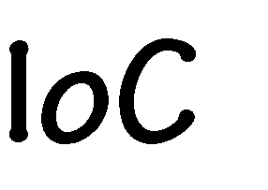






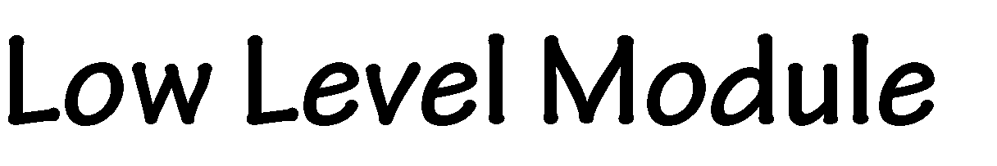
Stop thinking of high versus low Everything is peers

Slide 6
Interface Inversion
Don’t create an interface is there is only one implementation
There is a provider model
Allows substitution of implementation
User of a services does not know of any of the implementations
Hence, it is not in control. Control has been inverted

Slide 7
Flow inversion
Think command line vs GUI

Slide 8
Creation inversion
This is the core of most .NET IoC containers
Get rid of “new”
New needs to know implementation
You are now dependent
Creation of objects is inverted
It is created outside the using class
IoC container is an implementation of the Factory pattern

Slide 9
Give example of inversion of creation
Buttons

Slide 10
Different implementations
Factory pattern
Service locator
Dependency injection

Slide 11
Issues
My code still needs to “get” objects
I would prefer that I be given the objects so I don’t have to create them
This is solved by Injection

